Slide 1

Analyzing Neuroimaging Data with PySpark and Thunder

Slide 2
To understand brain function it was necessary to monitor and relate the functionality of large neuron data. One hour of brain imaging data of Larval Zebrafish will be one TB.
In this session we explore PySpark API for interacting with Spark through Python, and also Thunder project. Spark works well for large scale distributed computing. Thunder is project developed to process large scale image processing especially for Neural datasets.
Larval zebrafish brain sample images are used for this experiment. Extremely downgraded sample used to for analysis. Zebrafish is well known sample for neural analysis because of its transparency of brain activity and data size is when compared to other animals like mouse or human brain.

Slide 3
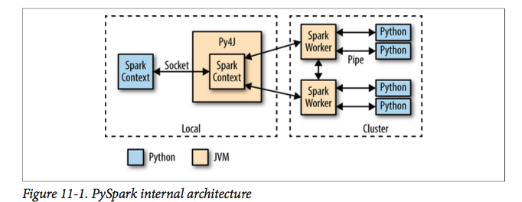
When Pyspark interpreter starts it starts JVM which will communicate over socket
Pyspark works by a project called Py4J.
JVM creates Sparkcontext and acts like an executer which is responsible for communication with other workers
Any API call is made on the Python RDD, code is serialized and send sent to executors.

Slide 4
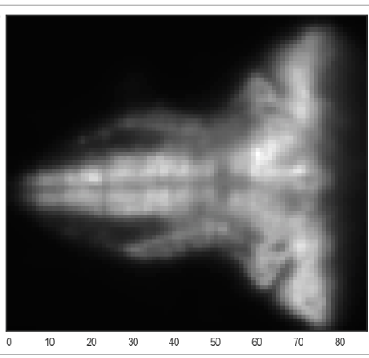
Pixel – smallest element in 2d image
Voxel – smallest element in 3d image
Stack – Stack of 2d images which will generate
3 D image
Subsampled Image

Slide 5
Thunder core data types
There two core data types in Thunder, Series and Images, both inherit from the Data class
Both have similar kind of methods to load data
fromarray()
frombinary()
fromexample()
frompath()

Slide 6
Categorising Neuron types with thunder
After converting Image data into series objects we can do some analysis with this data.
seriesRDD = tsc.loadSeries( 'path/to/thunder/python/thunder/utils/data/fish/bin
Dimensions: min=(0, 0, 0), max=(75, 86, 1), count=(76, 87, 2) [ 0 1 2 3 4 5 6 ... 234 235 236 237 238 239]
normalizedRDD = seriesRDD.normalize(baseline='mean')

Slide 7
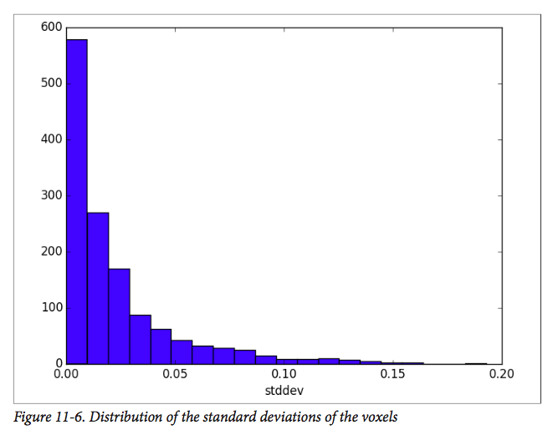
stddevs = (normalizedRDD
.seriesStdev()
.values()
.sample(False, 0.1, 0)
.collect())
plt.hist(stddevs, bins=20)
we’ll choose a threshold of 0.1 to look at the most “active” series

Slide 8
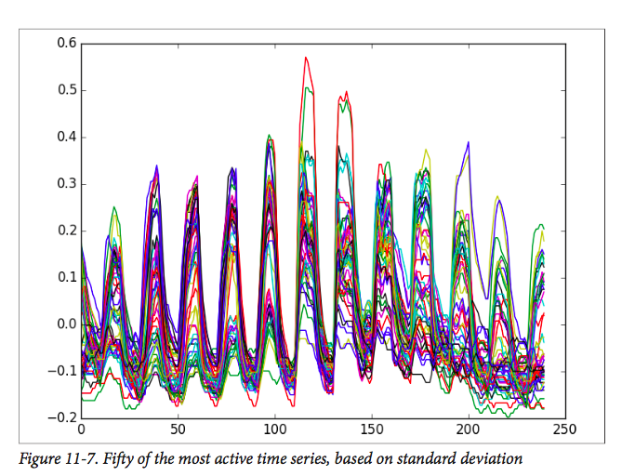
plt.plot(normalizedRDD.subset(50, thresh=0.1, stat='std').T)

Slide 9
we’ll use the K-means algorithm to cluster the various fish time series into multiple clusters to describe the classes of neural behavior. We develop two error metrics. The first one be the sum across all time series of the Euclidean distance from the time series to its cluster center. The second one will be a built-in metric of the KMeansModel object
from thunder import KMeans ks = [5, 10, 15, 20, 30, 50, 100, 200] models = [] for k in ks: models.append(KMeans(k=k).fit(normalizedRDD)
def model_error_1(model): def series_error(series):cluster_id = model.predict(series) center = model.centers[cluster_id] diff = center - series return diff.dot(diff) ** 0.5 return (normalizedRDD.apply(series_error).sum())

Slide 10
def model_error_2(model): return 1. / model.similarity(normalizedRDD).sum()
import numpy as np errors_1 = np.asarray(map(model_error_1, models)) errors_2 = np.asarray(map(model_error_2, models)) plt.plot( ks, errors_1 / errors_1.sum(), 'k-o', ks, errors_2 / errors_2.sum(), 'b:v')
model20 = models[3] plt.plot(model20.centers.T)

Slide 11
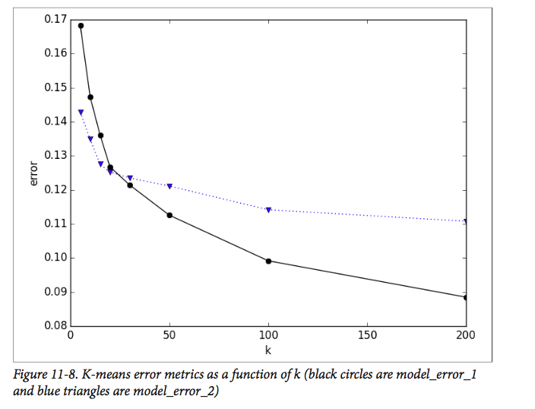
K= 20 is optimum value because even if increase K there is not much reduction in error relatively
It seems like k=20 might be a sharper elbow in the curve. Let’s visualize the cluster centers that we’ve learned from the data

Slide 12
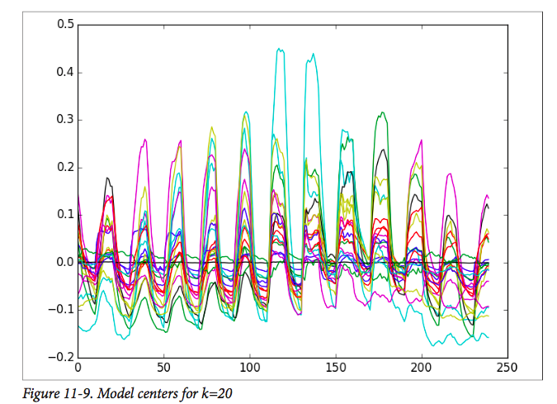

Slide 13
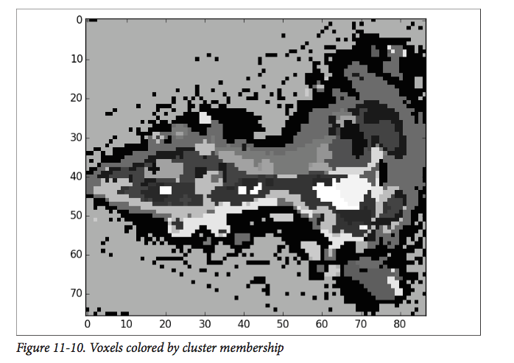
Plotting the images with the voxels colored according to their assigned cluster
from matplotlib.colors import ListedColormap by_cluster = model20.predict(normalizedRDD) .pack()
cmap_cat = ListedColormap
(sns.color_palette("hls", 10), name='from_list')
plt.imshow(by_cluster[:, :, 0], interpolation='nearest',
aspect='equal', cmap='gray')

Slide 14
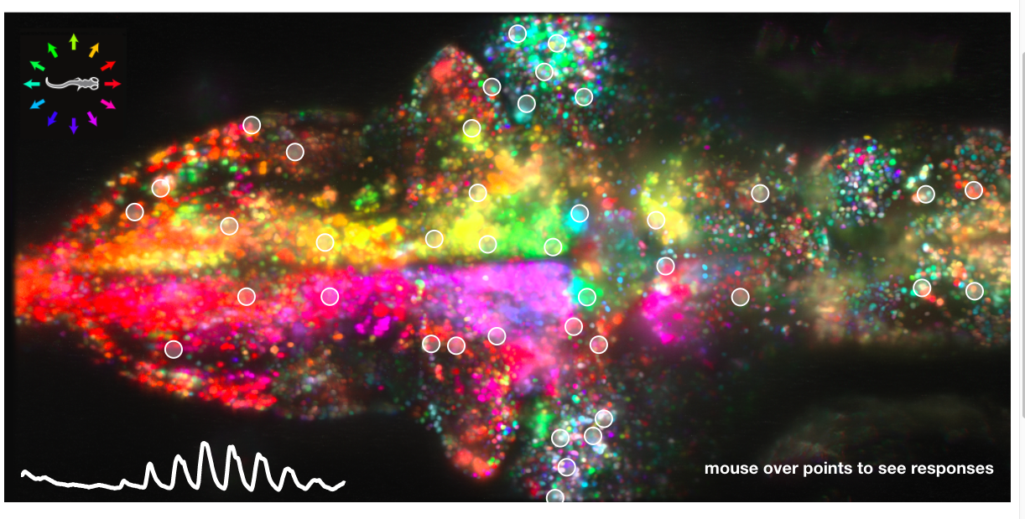

Slide 15
Ref:
http://thunder-project.org/
http://research.janelia.org/zebrafish/

